Slide 1
Immigration Information and Tips
Jessica A. Ramos
Senior Attorney
Legal Aid Society of Greater Cincinnati

Slide 2
Keep your address current
It is VERY important that your address is correct with the different parts of immigration dealing with your case – including USCIS, ICE, and the Immigration Court
Important mail, including hearing and interview notices, get sent to your address
Missing an interview or hearing can cause your case to be denied and even result in a deportation order being entered against you

Slide 3
Asylum
Available to those or are afraid to return to their home country because they fear harm
Unwilling or unable to return to his or her home country
Cannot obtain protection in that country
Has suffered past persecution or has a well-founded fear of future persecution in their home country
Persecution is on account of
race,
religion,
nationality,
membership in a particular social group, or
political opinion.
There are severe penalties for lying on an asylum application, including never being eligible for any other form of immigration relief and monetary fines.

Slide 4
Important Immigration Documents
Warrant for Arrest of Alien

Slide 5
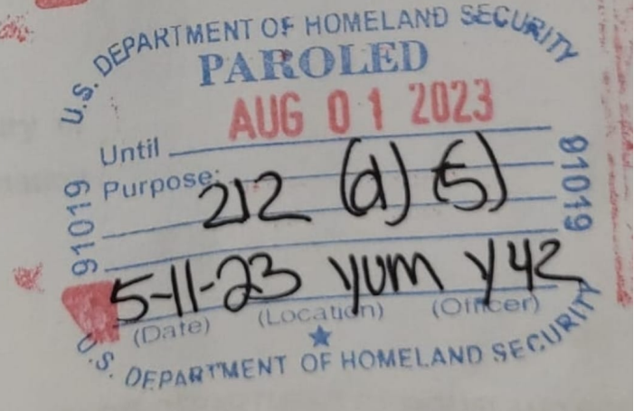
Important Immigration Documents
Parole Stamp:
Eligible for work permit only while parole is valid

Slide 6
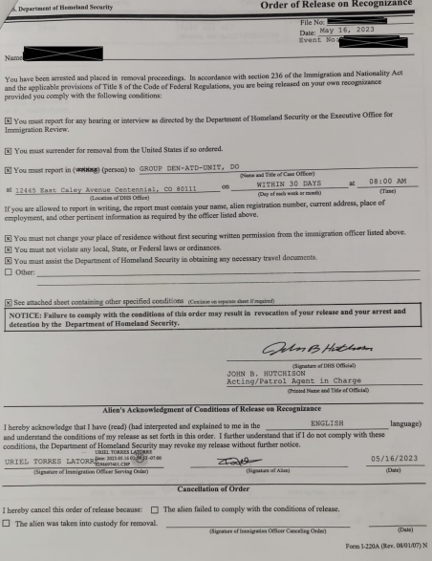
Important Immigration Documents
Release on Recognizance:
Generally, NOT eligible for work permit based on this document alone

Slide 7
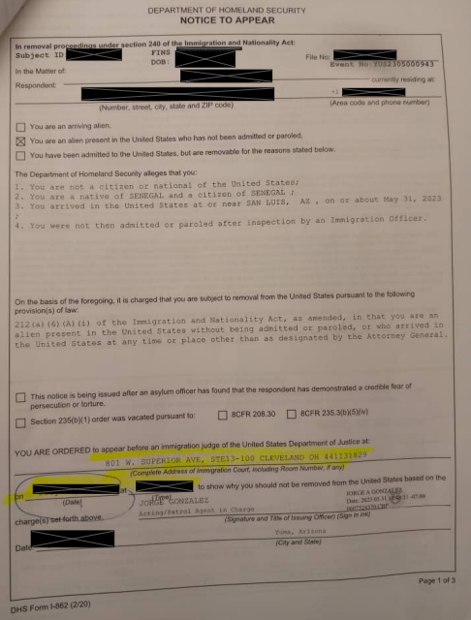
Important Immigration Documents
Notice to Appear

Slide 8
When is my hearing?
First, Check your Notice to Appear – but this can change
Second, Check online (see handout) or by phone (1-800-898-7180)
If it says the “A number is not found in the system” it means your file hasn’t been forwarded to the court yet, but it can be sent at any time, so keep checking weekly
On the day of your hearing – DO NOT arrive late – you could be ordered deported
At your first hearing you can file your asylum application if you haven’t already done so, but you do not present your case – that is scheduled for later
You can also ask for more time to find an attorney

Slide 9
One Year Filing Deadline
Generally, you MUST file for asylum within one year of your arrival in the United States and it is YOUR responsibility to make sure you meet this deadline
If you have a court hearing within your first year – file your completed asylum application at your hearing
If you have a court hearing but it is after your first anniversary has passed – you must file your asylum application with the Immigration Court BEFORE the one year has passed either in person or by mail
If you do not have a court hearing scheduled at all, you must file your asylum application with U.S. Citizenship and Immigration Services

Slide 10
Work Permits
If you were paroled into the U.S., then you are eligible for a work permit that is valid for the same amount of time as your parole is valid
If you were not paroled OR your parole has expired or is only valid for a very short time, you must file your asylum application first
You may then file for your work permit 150 days after your asylum application was received by the Immigration Court or USCIS

Slide 11
What can I do to prepare for my case now?
Collect all your immigration documents and documents about your case and store them in one place
Write down or audio record your story with details – be specific and give as many details as you can remember, especially with dates, places, and names if possible
REMEMBER – Everyone’s case is different

